Slide 1
Lectures on HPC/Parallel Computing Lecture 5
Andrew Pensoneault

Slide 2
Overview
Intro to GPUs
CUDA
Hello World on CUDA
CUDA Blocks
CUDA Threads
Synchronization

Slide 3
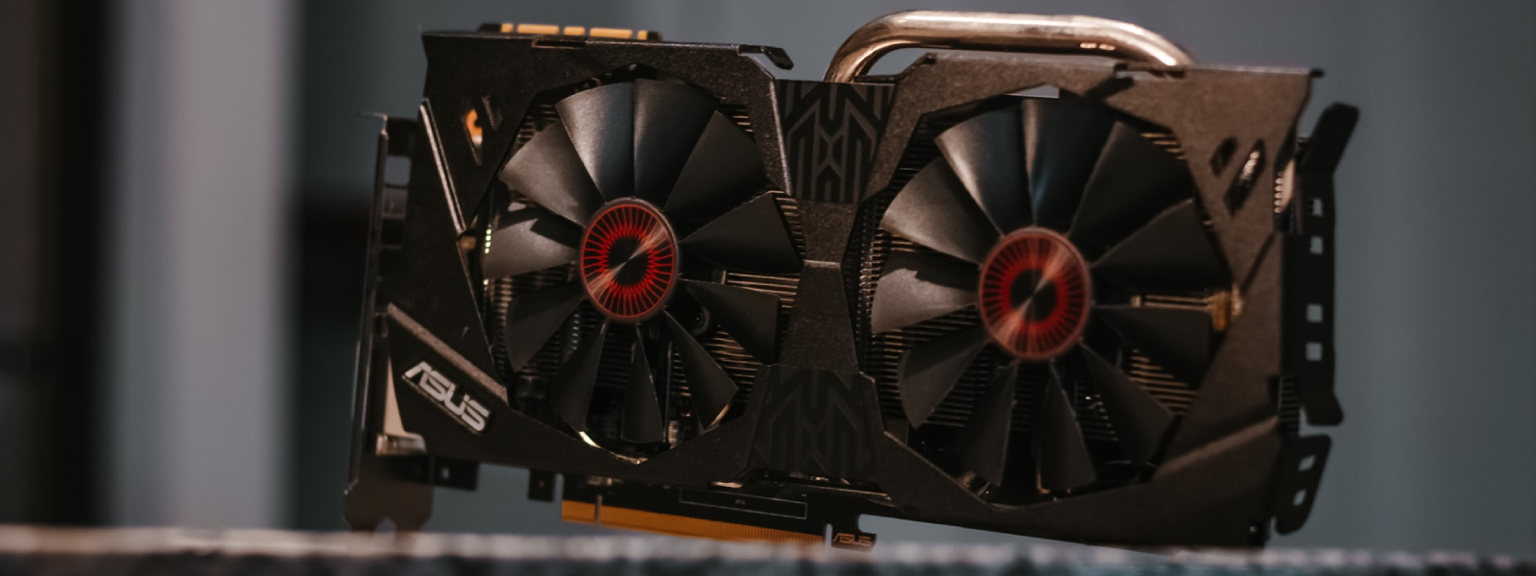
Intro to GPUs
A Graphics processing unit (GPU) is a specialized electronic circuit designed to manipulate and alter memory to modify frames for a display.
GPUs are also useful for doing many linear algebra operations and thus are useful for many mathematical applications.

Slide 4
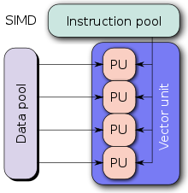
SIMD
Single instruction, multiple data (SIMD) is a type of parallel processing which involves a single operation (such as addition or multiplication) simultaneously on a set of data
GPUs operate mostly on a SIMD architecture
SIMD is highly powerful, however can have some disadvantages, such as with control flow

Slide 5
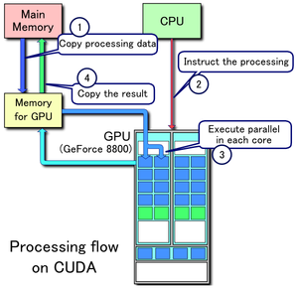
CUDA
Compute Unified Device Architecture (CUDA) is an API that allows software to use certain types of graphics processing unit for general purpose processing

Slide 6
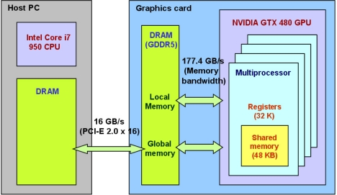
Terminology
Host: The CPU and its memory (host memory)
Device: The GPU and its memory (device memory)

Slide 7
CUDA on ARGON
To use cuda, we must first import it
module load cuda
To compile cuda code, we muse use nvcc
Afterwards, you may run the code via ./
Typically for cuda C code, we use the extension .cu instead of .c
Within the C code we will use the following libraries
#include <cuda_runtime_api.h>

Slide 8
Device and Host code
In C, host code is written as with normal C code.
To define a function to be run on the device, we must use the __global__ keyword
__global__ void myfunction(void){};
The __global__ keyword indicates that the code is device code and run from the host
To call device code, we must use the function name as well a <<<*,*>>>
myfunction<<<1,1>>>();
The two parameters define launch parameters

Slide 9
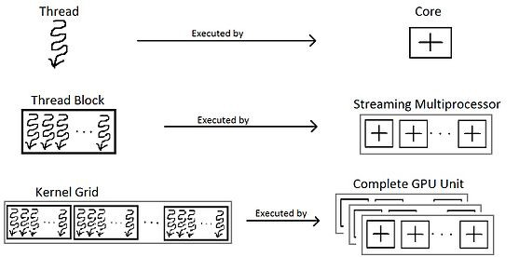
Device and Host code
myfunction<<<1,1>>>();
The first parameter defines the number of thread blocks in a grid and the second defines the number of threads in a block (i.e. think defining a matrix)

Slide 10

CUDA hello world
Host and device code are run asynchronously (i.e. after a kernel is launched, the host code continues to the next line)
To ensure synchronicity, we can use the cudaDeviceSynchronize()
GPU code is placed in a stream however, so if two kernels are to be launched, the second will start only after the first is done
The function cudaDeviceReset() destroys all cuda contexts and is used at the end to clean up

Slide 11

CUDA Addition

Slide 12
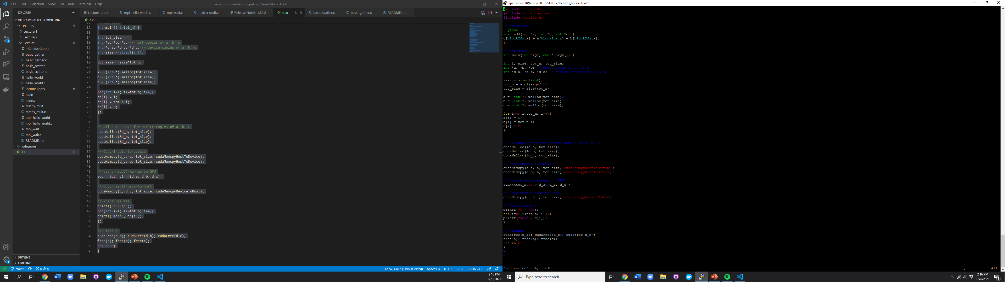
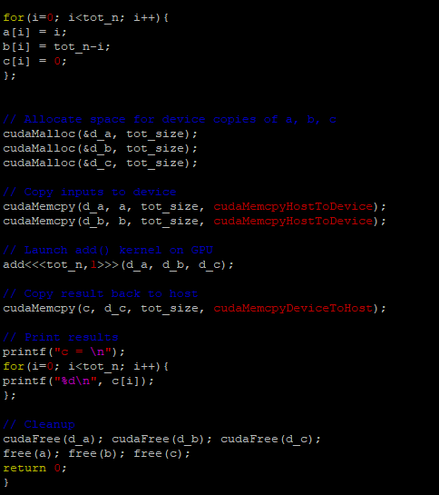
CUDA Vector Addition (using Thread Blocks)

Slide 13

CUDA Vector Addition (using Threads)

Slide 14
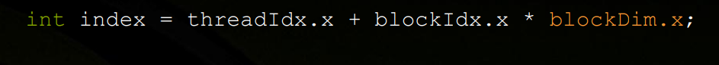
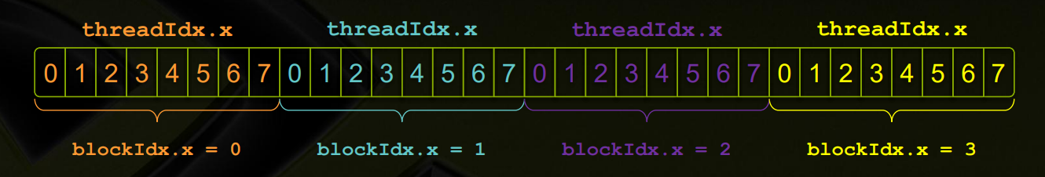
Blocks and threads
Thread blocks and threads can simultaneously be used.

Slide 15
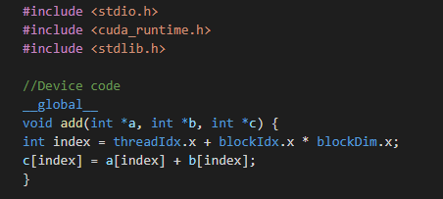
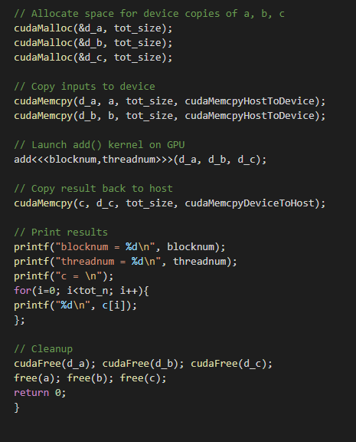
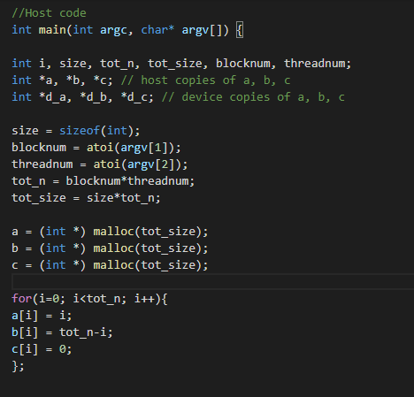
CUDA Vector Addition (using Blocks and Threads)

Slide 16
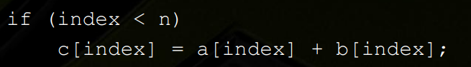
Issues with Arbitrary Vector sizes
If the vector being processed is not divisible by blockDim.x, then we will have issues with accessing beyond the array

Slide 17
Why use threads
Unlike parallel blocks, threads have mechanisms to efficiently:
Communicate
Synchronize
Within a block, threads share data via shared memory
We can allocate shared variables using __shared__, allocated per block
Data is not visible to threads in other blocks
Has all the same issues as with shared memory in OpenMP (i.e race conditions)
We can use void __syncthreads(); to synch threads

